Slide 1


Talgat Azhibekov
25/09/2023

Slide 2


Outline
Executive Summary
Introduction
Methodology
Results
Conclusion

Slide 3
Executive Summary
In this data science capstone project an outcome of Space X ship Falcon 9 first stage launch was predicted. First off all, data was collected using two methods requesting API and Web scraping. Then, data was processed by using pandas library followed by EDA techniques. EDA was performed with data visualization applying seaborn library and with SQL. During these stages data was cleaned and transformed to necessary formats, interesting feature relationships and dependencies were identified, landings success rates were calculated for each orbits and launch sites. To visually observe identified insights Plotly dashboards were created. Afterwards, each launch sites with landing outcomes were depicted on the world map by means of Folium functionality. Finally, predictive analysis was performed by using four classification models with accuracy 83.33%.

Slide 4
In 1961 first human successfully made one orbit around Earth. Since then active space exploration developed. The main drawback of such missions is extremely high budget. Nowadays, due to the usable first stage technology a Space X company can launch Falcon 9 rocket with a cost of 62 million dollars. While other providers offers start from 162 million dollars.
In this capstone, based on historical data, the Falcon 9 first stage successful landing will be predicted. Therefore, the cost of a launch can be determined. This information can be used if an alternate company wants to bid against SpaceX for a rocket launch.
Introduction

Slide 5

Section 1

Slide 6
Methodology
Executive Summary
Data collection methodology:
Describe how data was collected
Perform data wrangling
Describe how data was processed
Perform exploratory data analysis (EDA) using visualization and SQL
Perform interactive visual analytics using Folium and Plotly Dash
Perform predictive analysis using classification models
How to build, tune, evaluate classification models

Slide 7
Data Collection
Data sets were collected by 2 ways:
Made a get request to the Space X API.
Web scraping from the Wikipedia page

Slide 8
Data Collection – Space X API
Retrieve launch data from Space X API using "requests.get" method
Cleaned the requested data to discover more relevant information
Converted json result into a pandas dataframe
Filtered the dataframe to include only Falcon 9 launches
GitHub URL:
https://github.com/TalgatAzhibekov/IBM_DS_Capstone.git

Slide 9
Data Collection – web scraping
Web scrap Falcon 9 launch records with "BeautifulSoup"
Extract necessary column names from required table from HTML data
Create Pandas dataframe from extracted data
GitHub URL:
https://github.com/TalgatAzhibekov/IBM_DS_Capstone.git

Slide 10
Data wrangling
Uploaded pandas dataframe and identify the percentage of the missing values in each feature
Showed the number of launches for each site
Calculated number of each orbit
Calculated success rate of landing outcomes
Calculated mission outcome per landing type and labelled 0 or 1.
GitHub URL:
https://github.com/TalgatAzhibekov/IBM_DS_Capstone.git

Slide 11
EDA WITH DATA VISUALIZATION
By using the seaborn Python data visualization library the following main charts were plotted to identify useful relationships between data features:
FlightNumber vs LaunchSite – By increasing the flight numbers the number of successful landings increased from all launch sites.
FlightNumber vs PayloadMass – More massive the payload, the less likely the first stage will return.
FlightNumber vs Orbit – LEO orbit's Success is related to the number of flights. On the other hand, there is no relationship between flight number in GTO orbit.
Success rates of the orbits – ES-L1, GEO, HEO and SSO have the highest success rates.
Success rate vs Years – Success rate since 2013 kept increasing till 2020 with slight decrease in 2018.
GitHub URL:
https://github.com/TalgatAzhibekov/IBM_DS_Capstone.git

Slide 12
EDA WITH SQL
After loading the SQL extension and establishing a connection with the database the following main SQL queries were performed:
Displayed the unique launch sites and the total payload mass carried by boosters launched by NASA (CRS).
Identified the date when the first successful landing outcome in ground pad was achieved and the total number of successful and failure mission outcomes.
Listed the names of the boosters which have success in drone ship and have payload mass between 4000kg and 6000kg.
By using subquery found the names of the booster_versions which have carried the maximum payload mass.
By using complicated queries extracted necessary launch information occurred in specific date frame.
GitHub URL:
https://github.com/TalgatAzhibekov/IBM_DS_Capstone.git

Slide 13
Build an Interactive Map with Folium
To perform more interactive visual analytics using Folium the following main map objects were created:
Created circles for each launch sites with a popup labels showing their names.
Created markers at each launch sites with icons showing their names.
Created marker clusters at each launch sites with colour codes. Green – successful, Red- unsuccessful.
Calculated distances from launch sites to coastlines, railways, highways, cities and drew lines to show closest routes.
GitHub URL:
https://github.com/TalgatAzhibekov/IBM_DS_Capstone.git

Slide 14
Build a Dashboard with Plotly Dash
Added a Launch Site Drop-down Input Component – to see which one has the largest success count.
Added a callback function and displayed pie-chart – to show success rates of launch sites on pie-chart based on selected site dropdown.
Added a Range Slider to Select Payload – to easily select different payload range and see if variable payload is correlated with mission outcome.
Added a callback function and displayed scatter chart – to observe how payload may be correlated with mission outcomes for selected launch sites.
GitHub URL:
https://github.com/TalgatAzhibekov/IBM_DS_Capstone.git

Slide 15
Predictive Analysis (Classification)
Data preparation
Created a NumPy array from the column Class in data
Standardization of data
Train, test split
Logistic regression
Found best parameters
Calculated accuracy on train data
Calculated accuracy on test data
Support Vector Machine
Calculated accuracy on test data
Found best parameters
Calculated accuracy on train data
Calculated accuracy on test data
Decision Tree Classifier
Found best parameters
Calculated accuracy on train data
Calculated accuracy on test data
K nearest neighbors
Found best parameters
Calculated accuracy on train data
Test data highest accuracy: all models the same
Best Model
Train data highest accuracy: Decision Tree model
GitHub URL:
https://github.com/TalgatAzhibekov/IBM_DS_Capstone.git

Slide 16
Results
Exploratory data analysis results
Interactive analytics demo in screenshots
Predictive analysis results
GitHub URL:
https://github.com/TalgatAzhibekov/IBM_DS_Capstone.git

Slide 17

Section 2

Slide 18
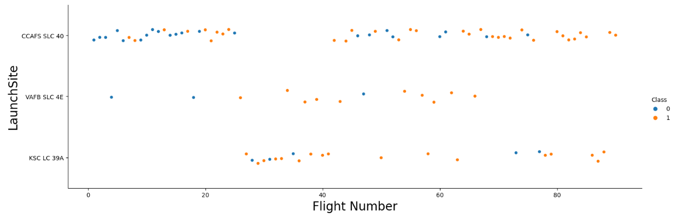
Flight Number vs. Launch Site
By increasing the flight numbers the number of successful landings increased from all launch sites
GitHub URL:
https://github.com/TalgatAzhibekov/IBM_DS_Capstone.git

Slide 19
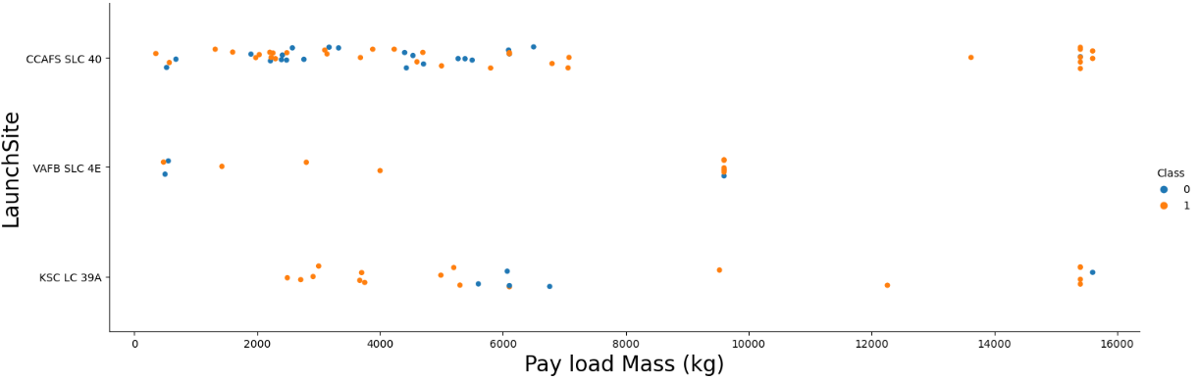
Payload vs. Launch Site
It is shown on this scatter point chart that the VAFB-SLC 4E launchsite has no rockets launched for heavy payload mass(greater than 10000kg). Also for CCAFS SLC 40 launchsite success rate increases above pay load mass 8000kg.
GitHub URL:
https://github.com/TalgatAzhibekov/IBM_DS_Capstone.git

Slide 20
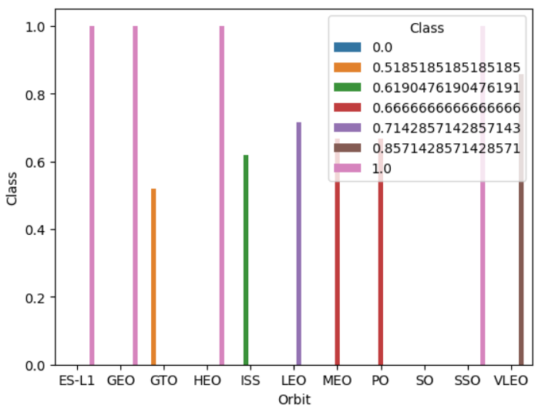
Success Rate vs. Orbit Type
It is shown on this bar chart that the orbits ES-L1, GEO, HEO and SSO have the highest success rates.
GitHub URL:
https://github.com/TalgatAzhibekov/IBM_DS_Capstone.git

Slide 21
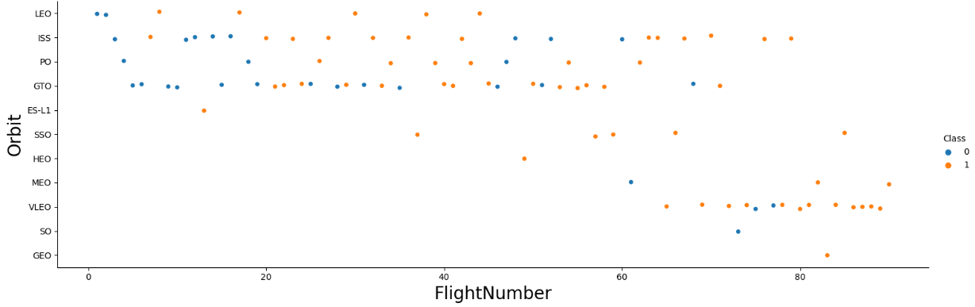
Flight Number vs. Orbit Type
LEO orbit's Success is related to the number of flights. On the other hand, there is no relationship between flight number in GTO orbit.
GitHub URL:
https://github.com/TalgatAzhibekov/IBM_DS_Capstone.git

Slide 22
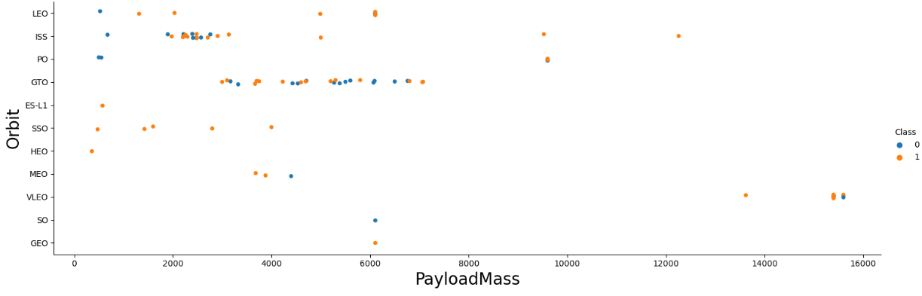
Payload vs. Orbit Type
With heavy payloads the successful landing rate are higher for PO, LEO and ISS.
However for GTO it cannot be distinguished well as both positive and negative landings are both there.
GitHub URL:
https://github.com/TalgatAzhibekov/IBM_DS_Capstone.git

Slide 23
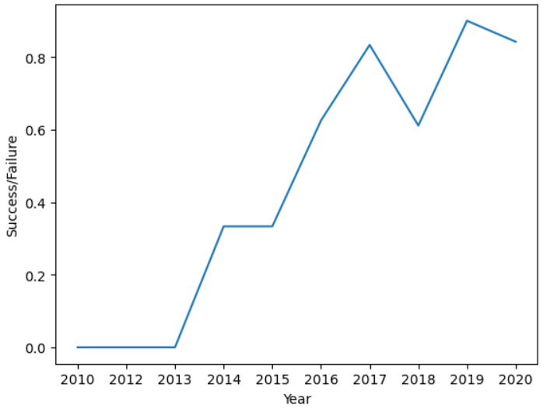
Launch Success Yearly Trend
Success rate since 2013 kept increasing till 2020 with slight decrease in 2018
GitHub URL:
https://github.com/TalgatAzhibekov/IBM_DS_Capstone.git

Slide 24
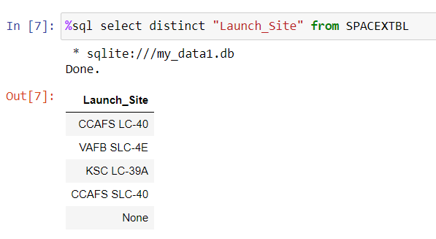
All Launch Site Names
By implementing SQL request the 4 unique launch sites were identified.
GitHub URL:
https://github.com/TalgatAzhibekov/IBM_DS_Capstone.git

Slide 25
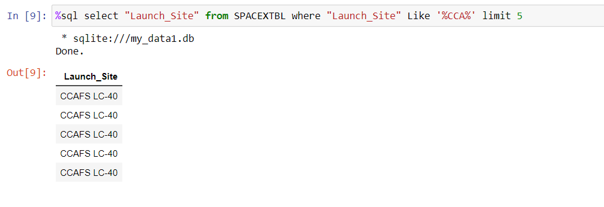
Launch Site Names Begin with 'CCA'
By implementing SQL request with limitation the 5 launch sites beginning from CCA were identified.
GitHub URL:
https://github.com/TalgatAzhibekov/IBM_DS_Capstone.git

Slide 26
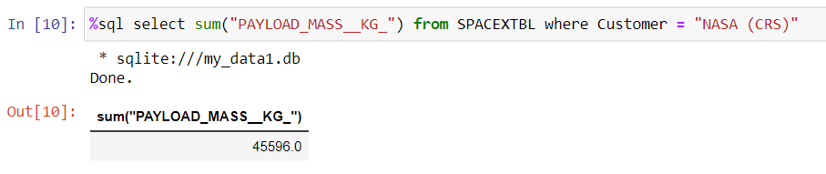
Total Payload Mass
By using sum function the total payload mass was calculated for "NASA (CRS)".
GitHub URL:
https://github.com/TalgatAzhibekov/IBM_DS_Capstone.git

Slide 27
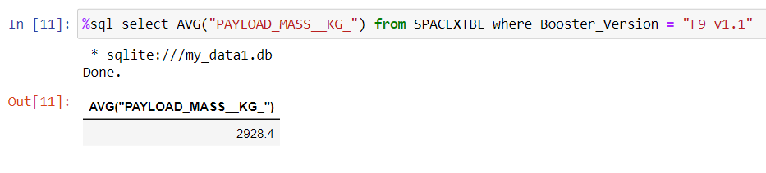
Average Payload Mass by F9 v1.1
By using AVG function the average payload mass was calculated for booster version "F9 v1.1".
GitHub URL:
https://github.com/TalgatAzhibekov/IBM_DS_Capstone.git

Slide 28
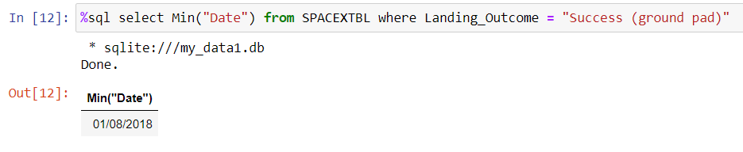
First Successful Ground Landing Date
By using Min function the first successful ground landing date was identified.
GitHub URL:
https://github.com/TalgatAzhibekov/IBM_DS_Capstone.git

Slide 29
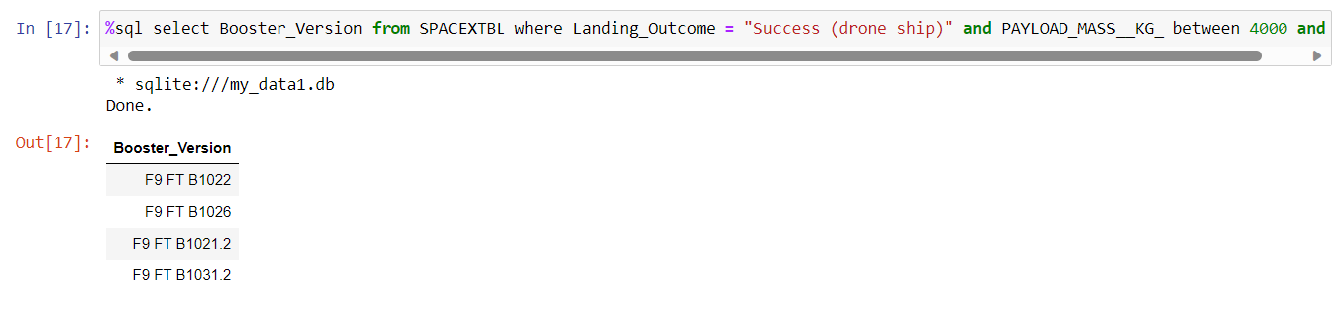
Successful Drone Ship Landing with Payload between 4000 and 6000
By using between function the successful drone ship landing with payload more than 4000kg and less than 6000kg were identified.
GitHub URL:
https://github.com/TalgatAzhibekov/IBM_DS_Capstone.git

Slide 30
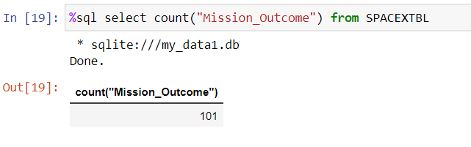
Total Number of Successful and Failure Mission Outcomes
By using count function the total number of successful and failure mission outcomes were found.
GitHub URL:
https://github.com/TalgatAzhibekov/IBM_DS_Capstone.git

Slide 31
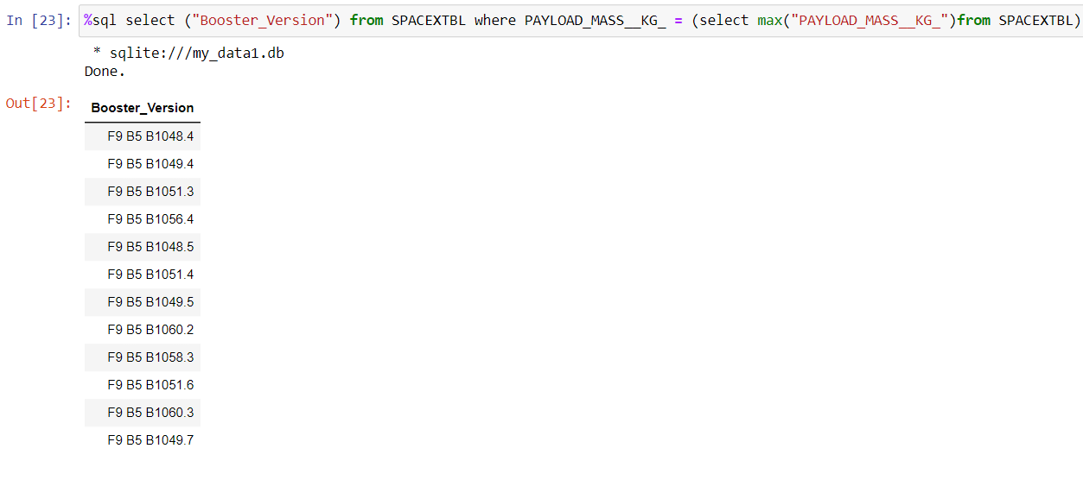
Boosters Carried Maximum Payload
By using subquery and max function boosters with maximum payloads were listed.
GitHub URL:
https://github.com/TalgatAzhibekov/IBM_DS_Capstone.git

Slide 32
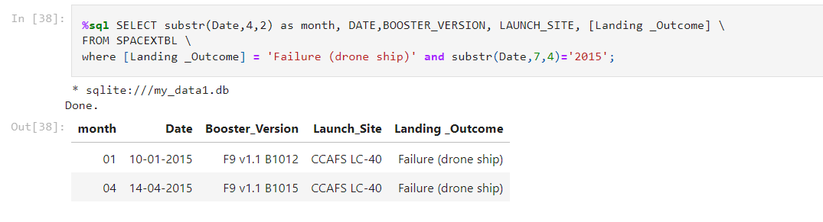
2015 Launch Records
By using special date format displayed main information regarding failure drone ship in 2015
GitHub URL:
https://github.com/TalgatAzhibekov/IBM_DS_Capstone.git

Slide 33
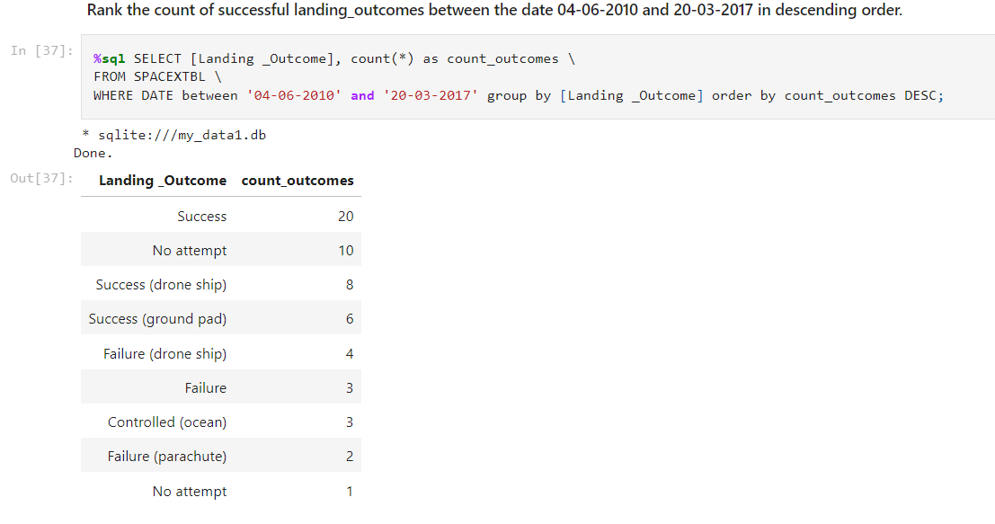
Rank Landing Outcomes Between 2010-06-04 and 2017-03-20
By using count function listed landing outcomes between 04/06/2010 and 20/03/2017 in descending order.
GitHub URL:
https://github.com/TalgatAzhibekov/IBM_DS_Capstone.git

Slide 34

Section 3

Slide 35
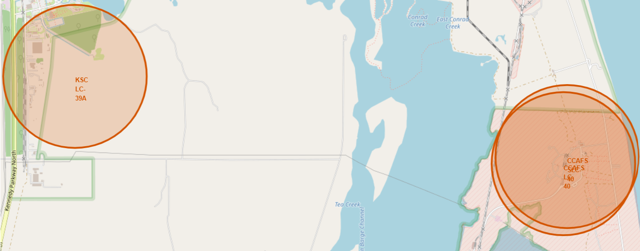
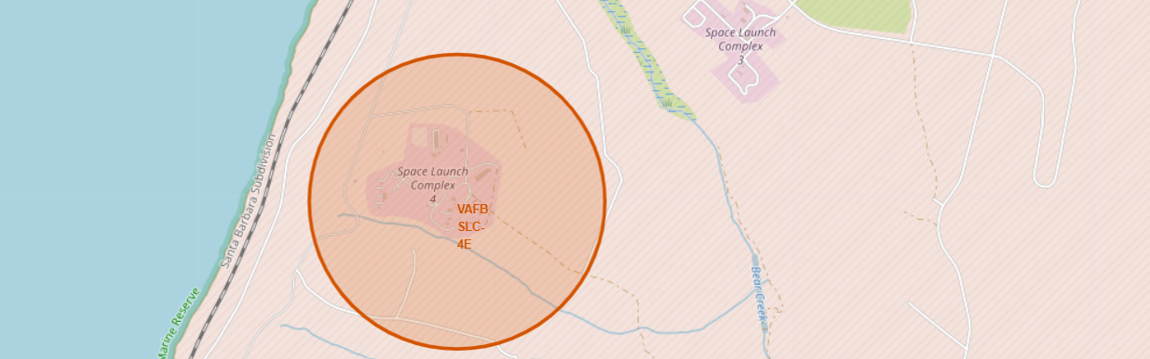
Launch sites locations on the map
By creating Folium map markers and circles displayed 4 launch site locations on the map. It can be observed that 3 launch sites are located very close to each other and 2 of them overlapping.
GitHub URL:
https://github.com/TalgatAzhibekov/IBM_DS_Capstone.git

Slide 36
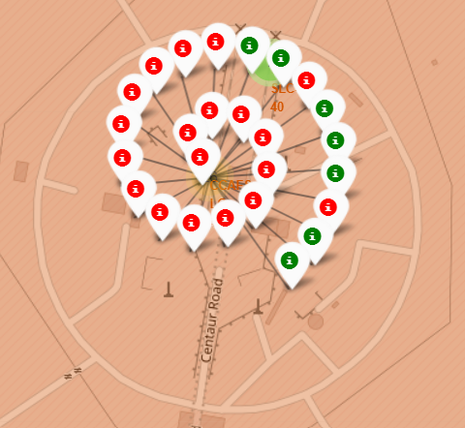
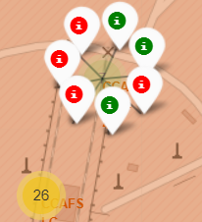
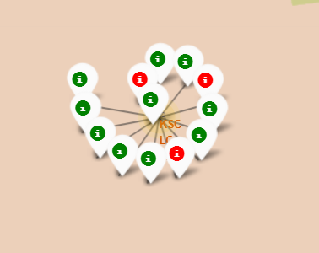
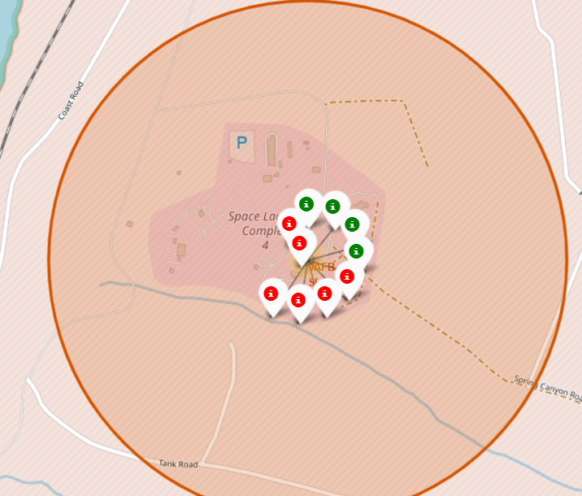
Launch outcomes
Green – Successful landing
Red – Unsuccessful landing
KSC-LC-39A: highest success rate
CCAFS-LC-40: largest number of launches, but most of them were unsuccessful
GitHub URL:
https://github.com/TalgatAzhibekov/IBM_DS_Capstone.git

Slide 37
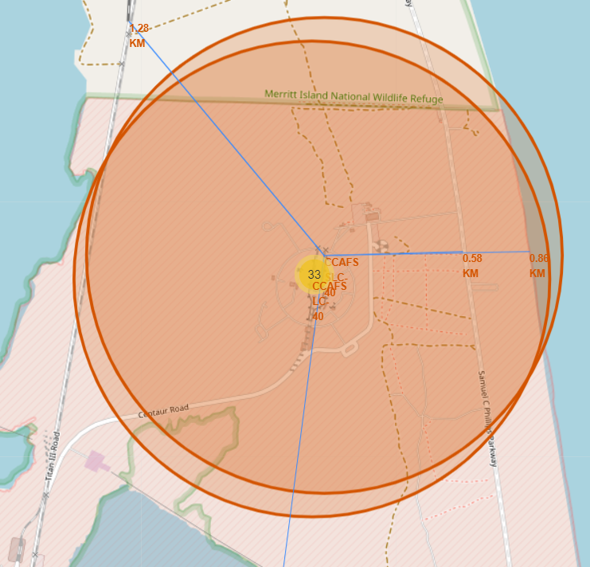
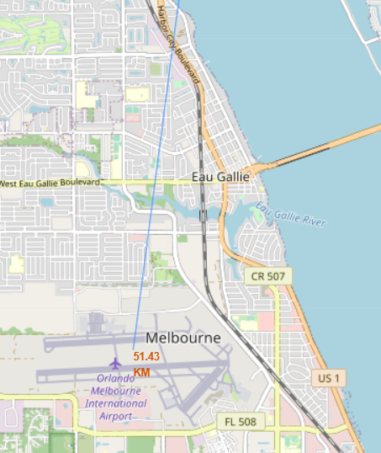
Distances from CCAFS-SLC-40 launch site to its proximities
Distances:
To the coastline: 0.86 km
To the highway: 0.58 km
To the railroad: 1.28 km
To the city: 51.43 km
GitHub URL:
https://github.com/TalgatAzhibekov/IBM_DS_Capstone.git

Slide 38

Section 5

Slide 39
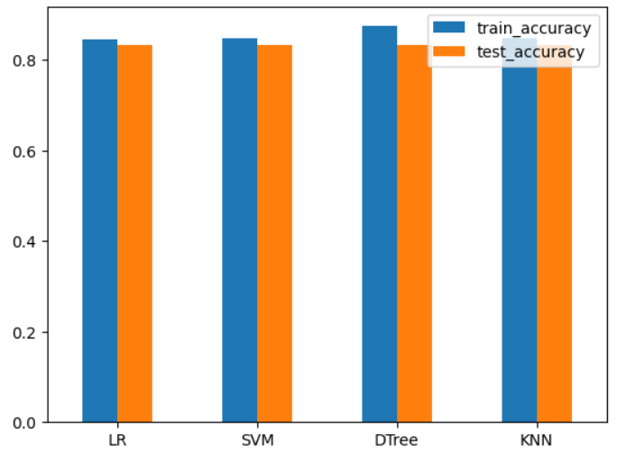
Classification Accuracy
Test_data accuracy for all models is the same: 0.8333
Train_data accuracy:
Decision Tree: 0.875
2) Support Vector Machine: 0.8482
3) K nearest neighbour: 0.8482
4) Linear Regression: 0.8464
As can be seen train data accuracies almost the same within the models. Only Decision Tree model has a slight higher score.
GitHub URL:
https://github.com/TalgatAzhibekov/IBM_DS_Capstone.git

Slide 40
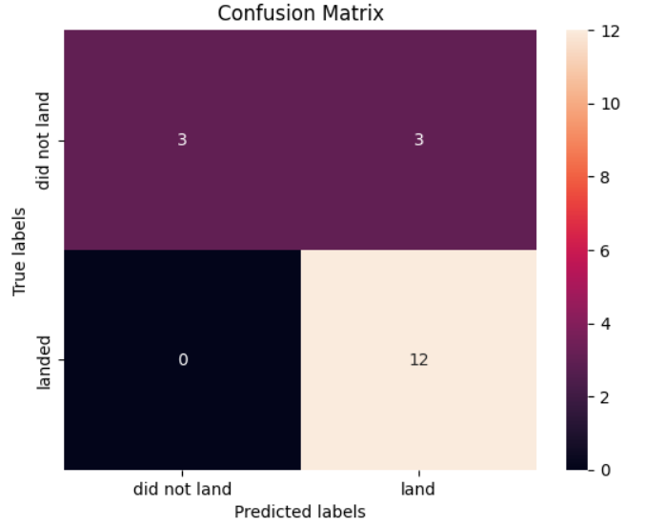
Confusion matrix
Confusion matrixes of all models revealed the same, as test_data accuracy was the same.
It is seen that models can distinguish between the different classes quite good. The major problem is false positives, where models predicted 3 launches as successful landings, in fact they did not land.
GitHub URL:
https://github.com/TalgatAzhibekov/IBM_DS_Capstone.git

Slide 41
Conclusions
It was a quite long journey which included all main stages of a data science project.
From EDA with visualization it was revealed that landing success increased with the number of flights. Overall success rate kept increasing from 2013 till 2020 with slight decrease in 2018.
From Folium maps activities the launching site locations hidden peculiarities discovered. So that they are located close to the equator line, coastlines and railroads. On the other hand, far away from big cities.
It is interesting to note that all four machine learning models (LR, SVM, DTree, KNN) showed exactly the same accuracy on test data 83.33%. While on train data the decision tree model calculated the best score 87.5% with minor difference from other models.
In conclusion, being able to predict the landing outcome of the Falcon 9's first stage with 83.33% accuracy gives enough confidence to be more prepared for future launches.

Slide 42


